Slide 1
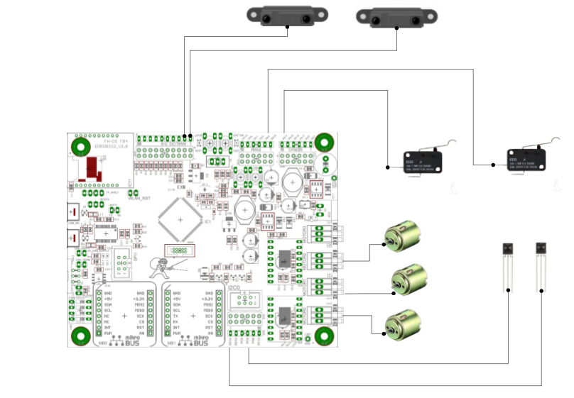
DISTANCE LEFT
DISTANCE RIGHT
ADC 1
ADC 0
PB11
SWITCH LEFT
SWITCH RIGHT
PB3
MOTOR2
MOTOR LEFT
IR LEFT
IR RIGHT
MOTOR CENTER
MOTOR1
MOTOR0
MOTOR RIGHT
PD14
PC9

